Slide 1

Noir Cafe
Your Trustworthy Desktop Application
Made By : Mahnoor Babar
Nestled in the heart of the city, Café Noir is more than just a café—it’s a haven for those who savor the rich, deep flavors of life. From the moment you step through our doors, you’re enveloped in an atmosphere of sophistication and warmth, where every detail is crafted to perfection.

Slide 2

Introducing the Noir Cafe
In the bustling world of café operations, efficiency and organization are key to delivering exceptional customer experiences and maintaining smooth daily operations. A Café Management System (CMS) is a comprehensive tool designed to streamline and enhance the management of your café, ensuring that every aspect of your business runs seamlessly.

Slide 3
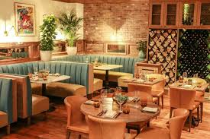
Background
The evolution of the café industry has been closely tied to advancements in technology, with the Café Management System (CMS) emerging as a pivotal innovation in recent years. As cafés and coffee shops have grown in complexity and competition, the need for efficient management tools has become increasingly apparent.

Slide 4
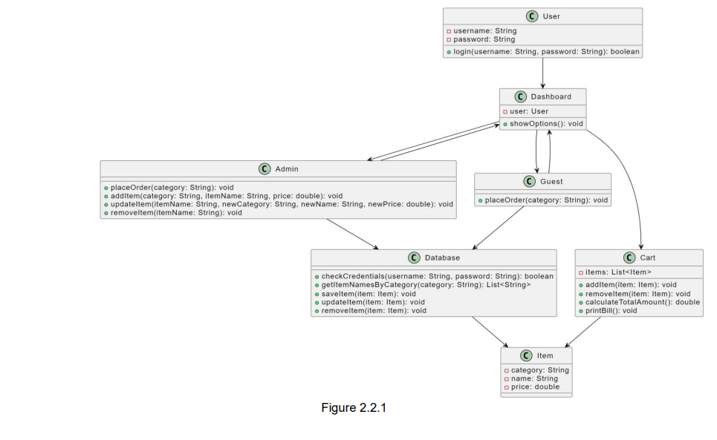
Class Diagram

Slide 5
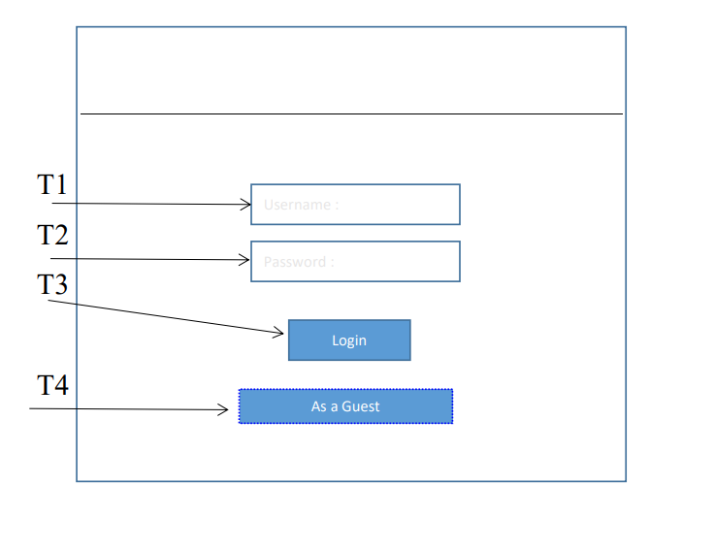
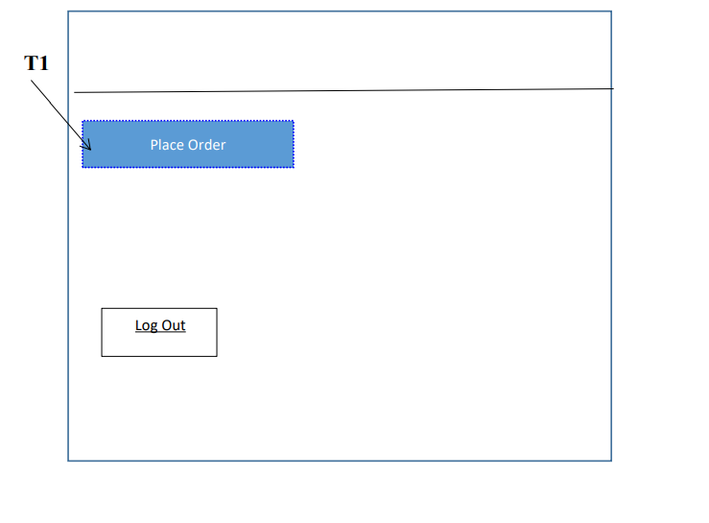
WireFrames

Slide 6
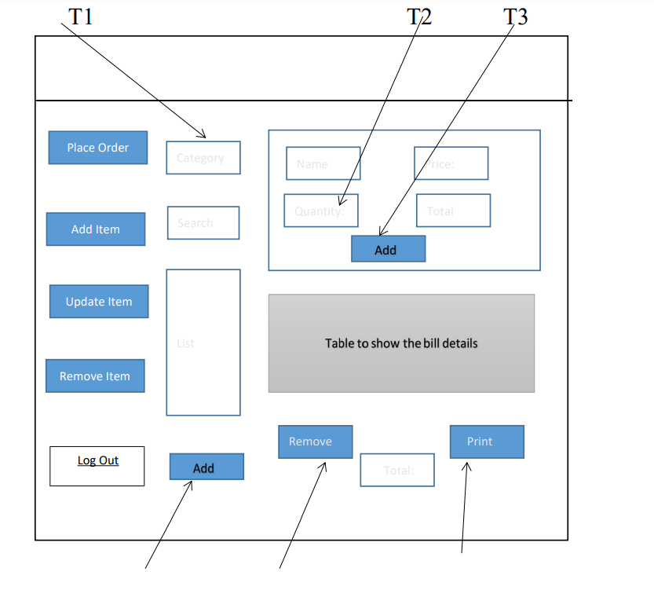
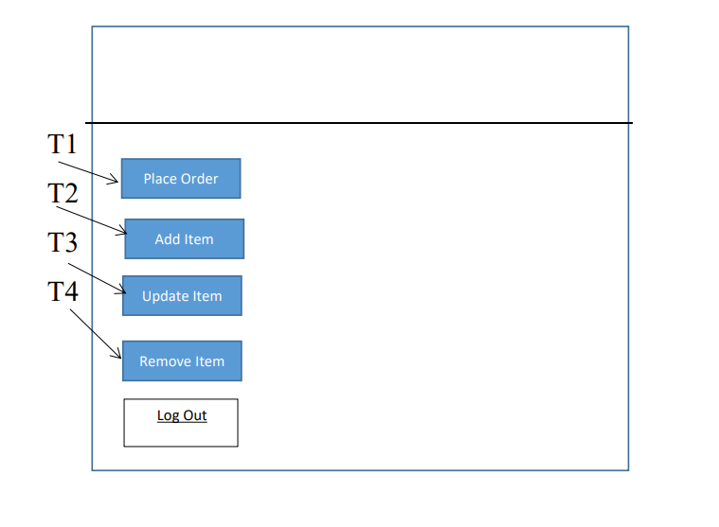
WireFrames

Slide 7
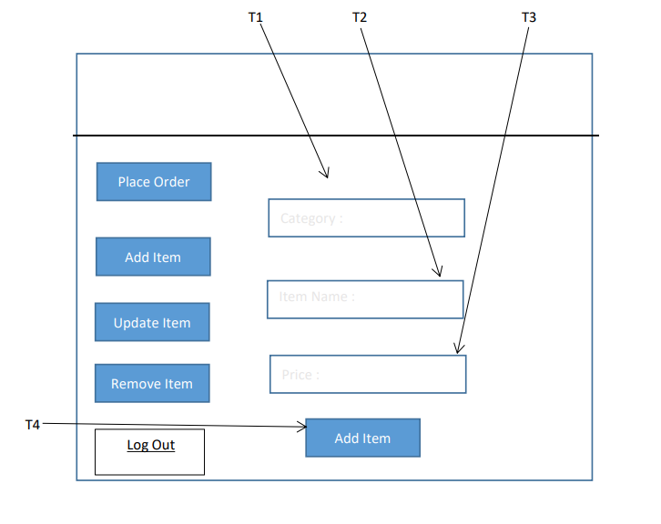
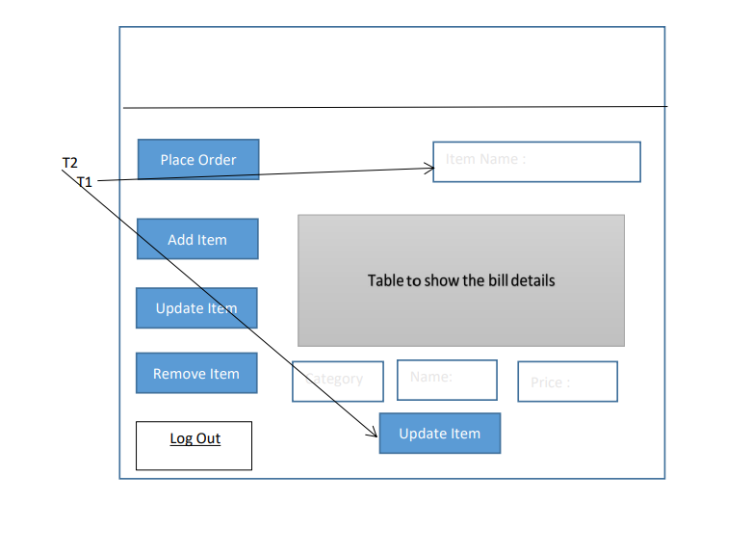
WireFrames

Slide 8
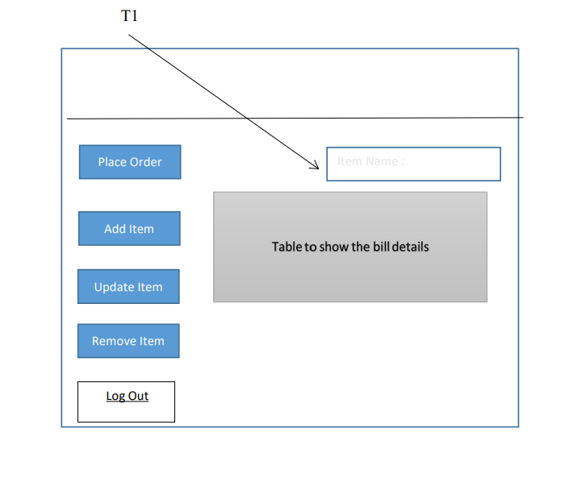
WireFrames

Slide 9
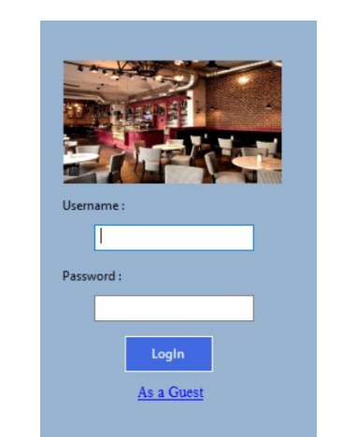
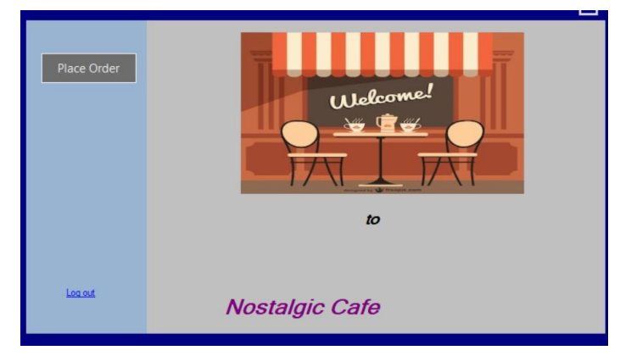
Final Design

Slide 10
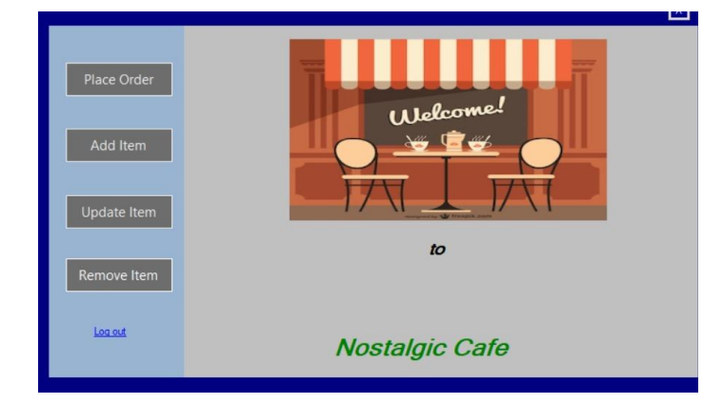
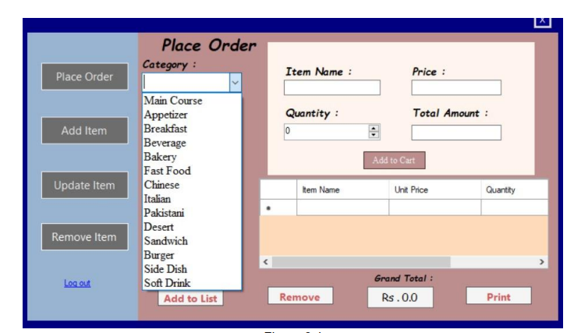
Final Design

Slide 11
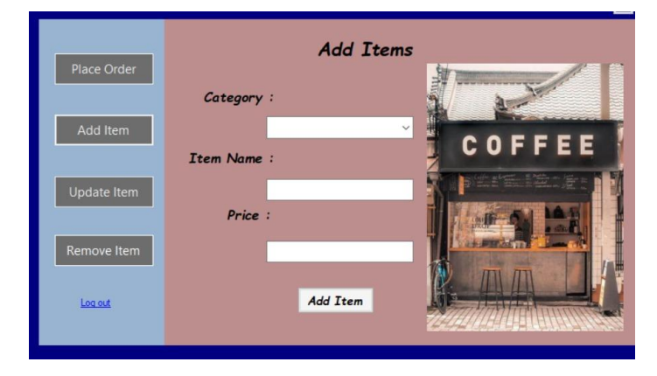
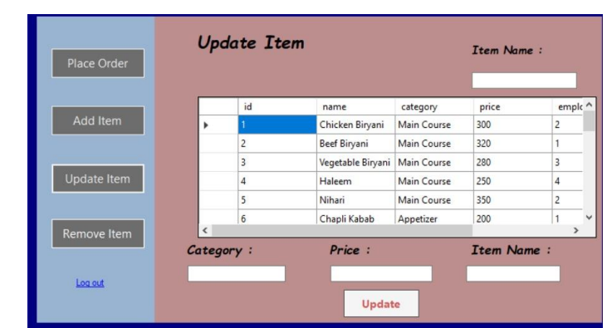
Final Design

Slide 12
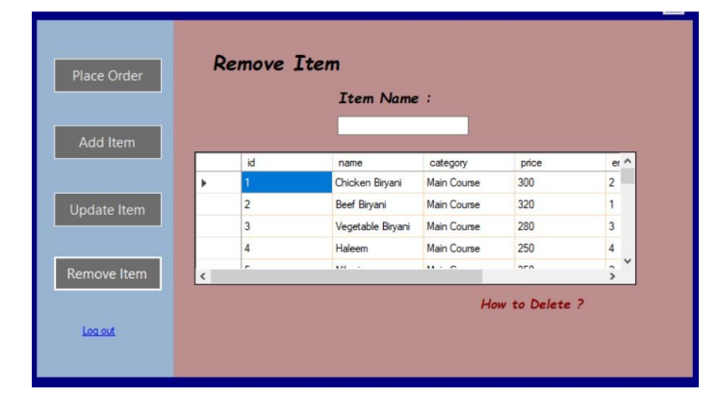
Final Design

